Slide 1

Electronics Circuit Simulator
OOP_HUST_Group 17

Slide 2





GROUP MEMBERS:
1
TRỊNH THỊ THUỲ DƯƠNG
20226034
2
ĐOÀN THỊ THU QUYÊN
20226063
3
DƯƠNG PHƯƠNG THẢO
20226001

Slide 3
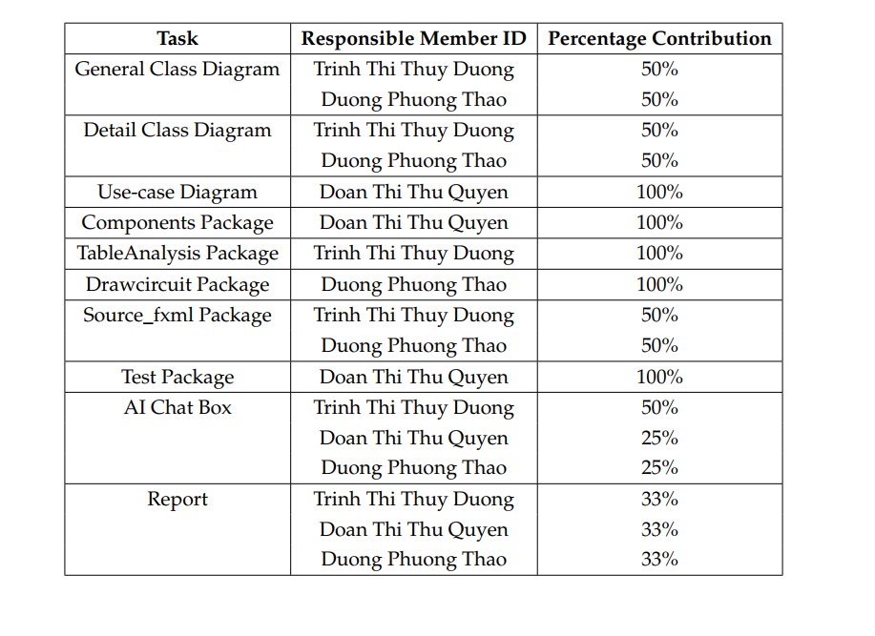

Slide 4



CONTENT
01
PROBLEM STATEMENT
02
USE CASE DIAGRAM
03
GENERAL CLASS DIAGRAM

Slide 5
CONTENT
04
PACKAGE CLASS DIAGRAM
05
OOP TECHNIQUE
06
AI APPLICATION
07
PROJECT DEMO

Slide 6
I. PROBLEM STATEMENT

Slide 7




I. PROBLEM STATEMENT
a. Context and intro to approach
Real-Time Calculations:
Analyze components
Compute voltage, current, resistance, etc.
Circuit Diagram Drawing:
Sketch circuits
Connect components
Add Components
Chatbot Integration:
ChatGPT API for guidance and explanations

Slide 8

II. USE CASE DIAGRAM

Slide 9
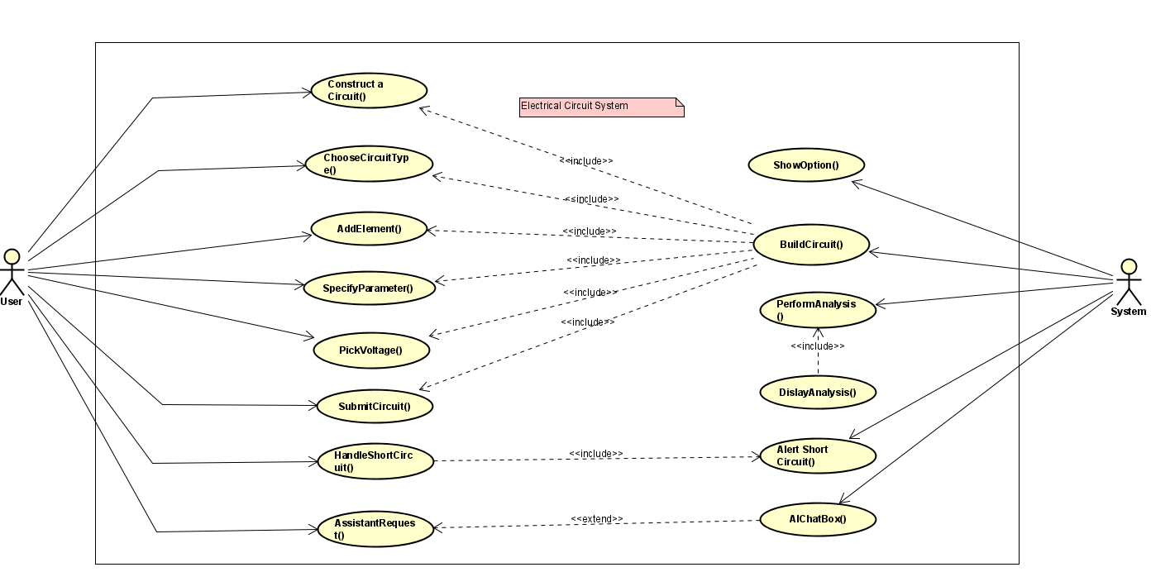


Slide 10
III. GENERAL CLASS DIAGRAM

Slide 11
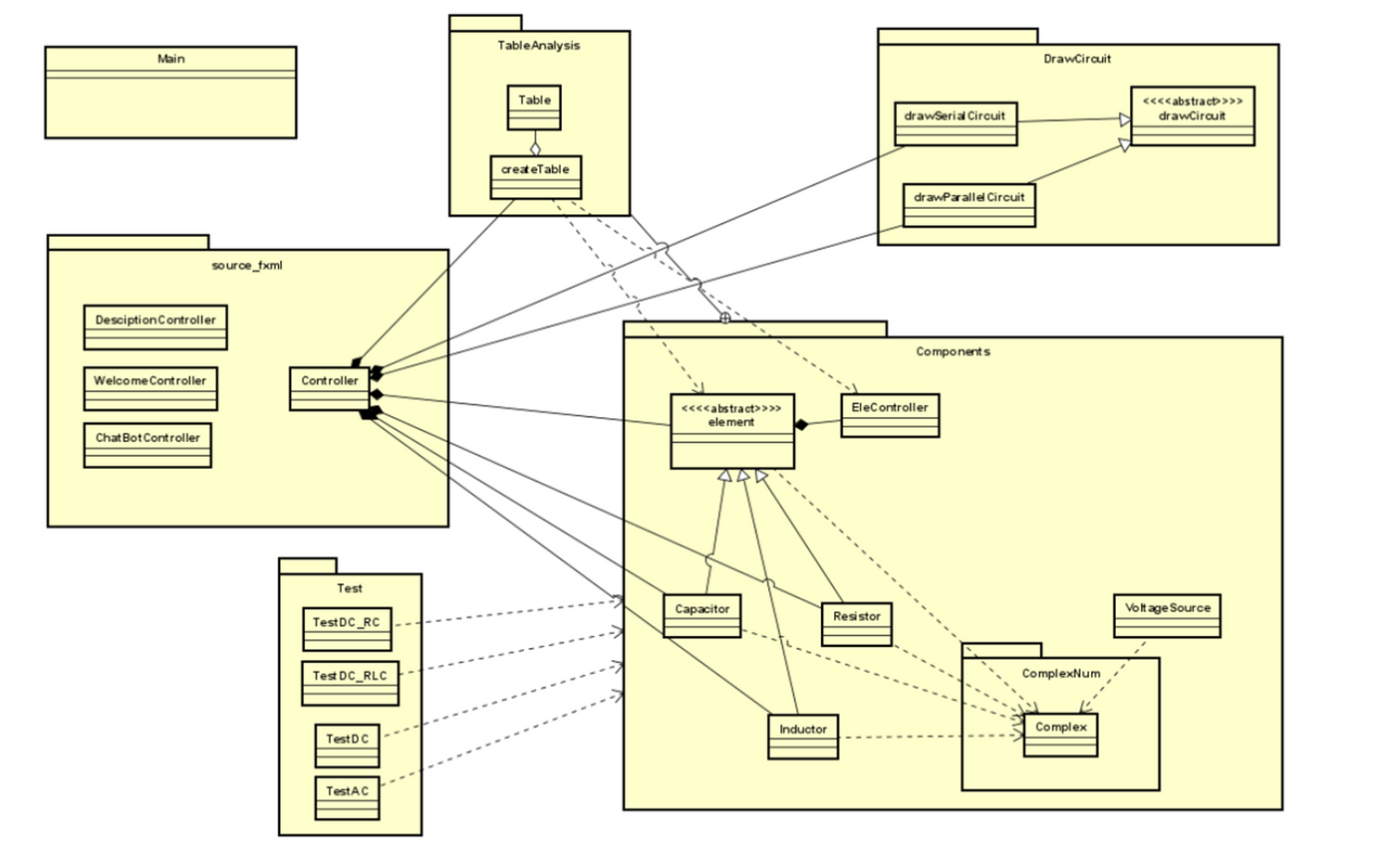
III.General Diagram

Slide 12
IV. Pakage Detail

Slide 13
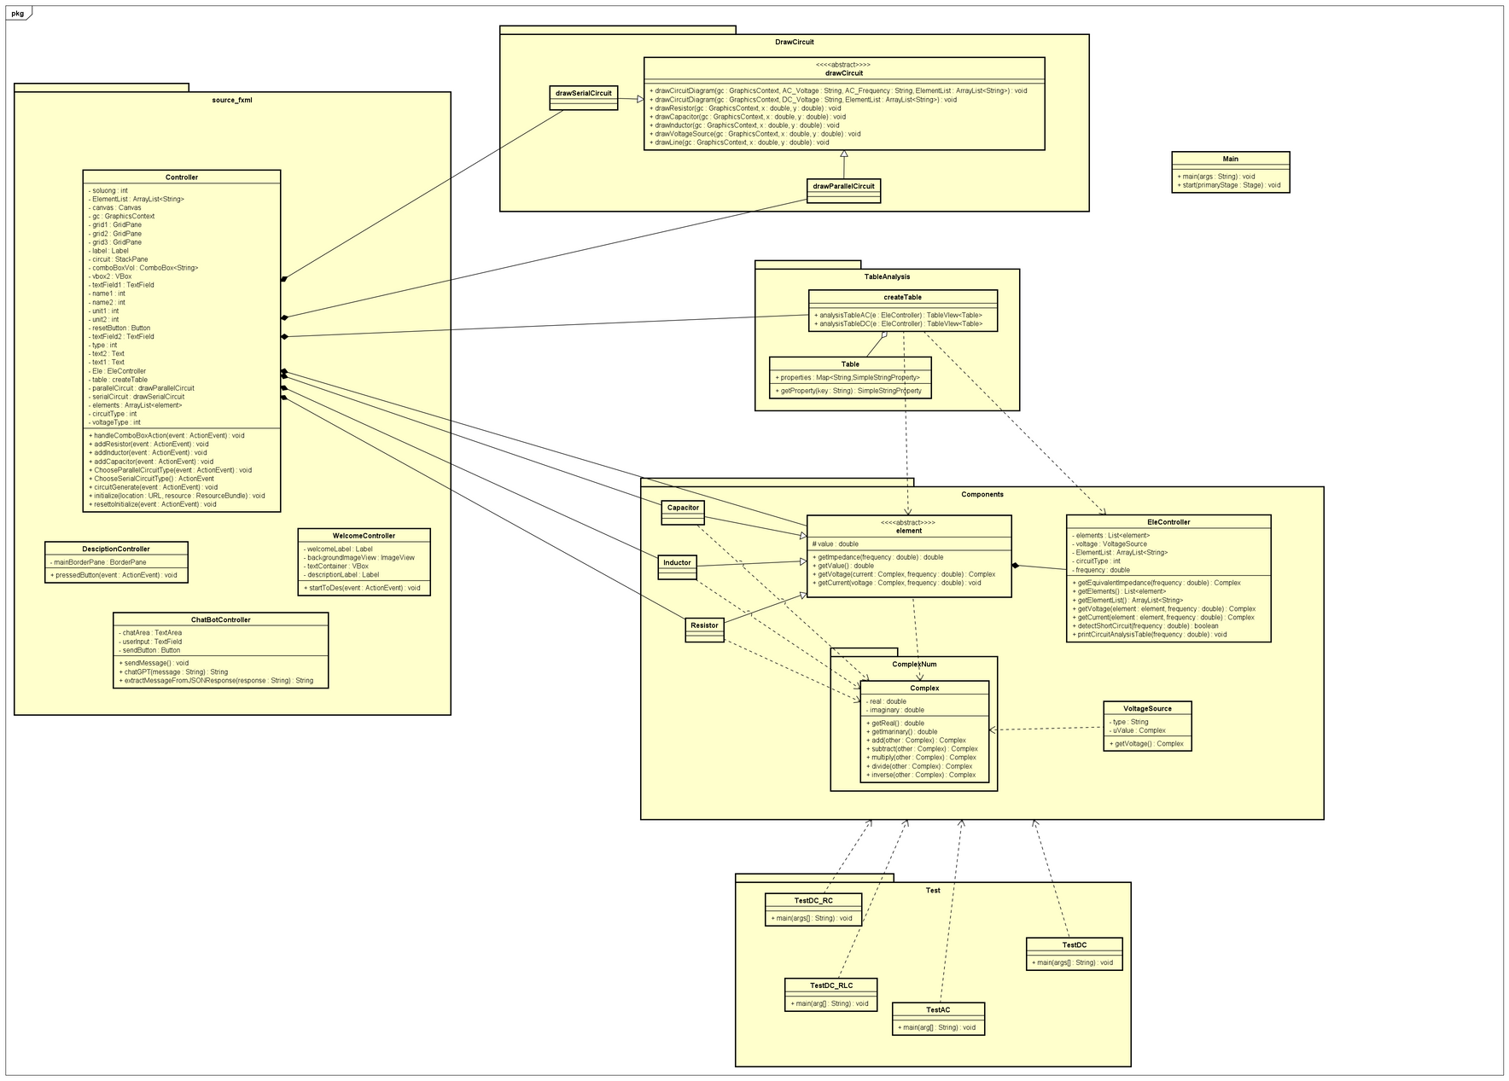

Slide 14
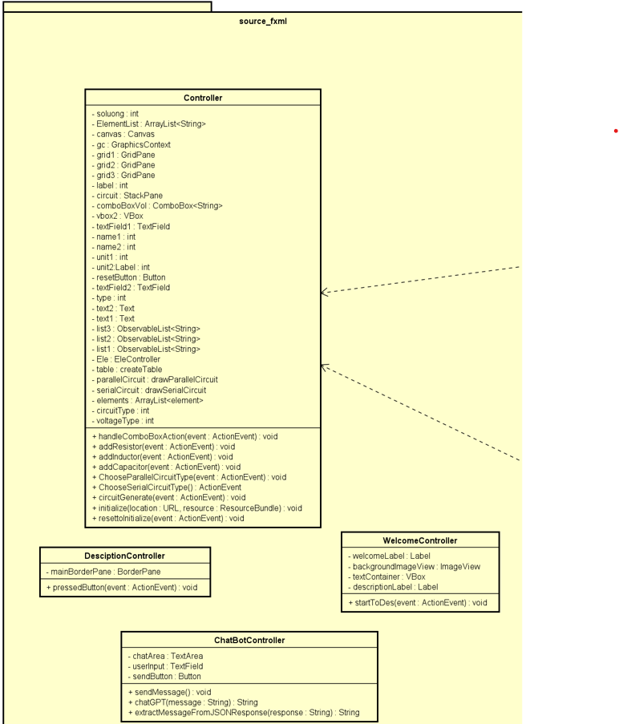
1. Package
source_fxml

Slide 15
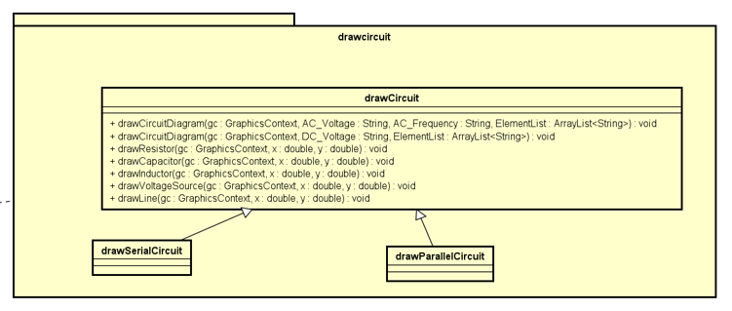
2. Package DrawCircuit

Slide 16
3. Package Test

Slide 17
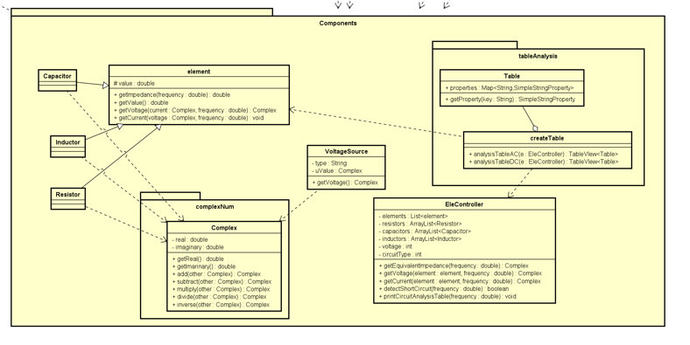
4. Package Components

Slide 18
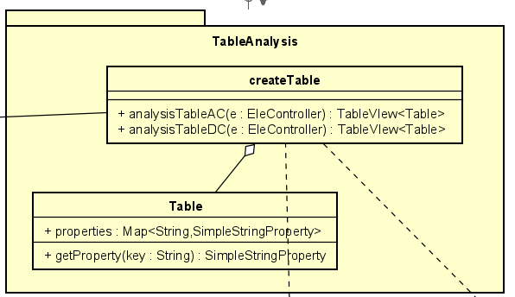
5. Package TableAnalysis

Slide 19
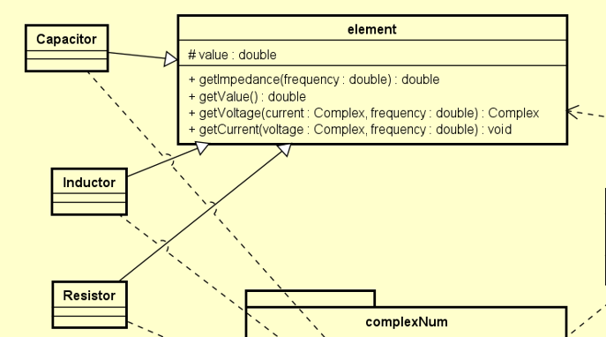

V. OOP TECHNIQUE
Inheritance & Abstraction:

Slide 20
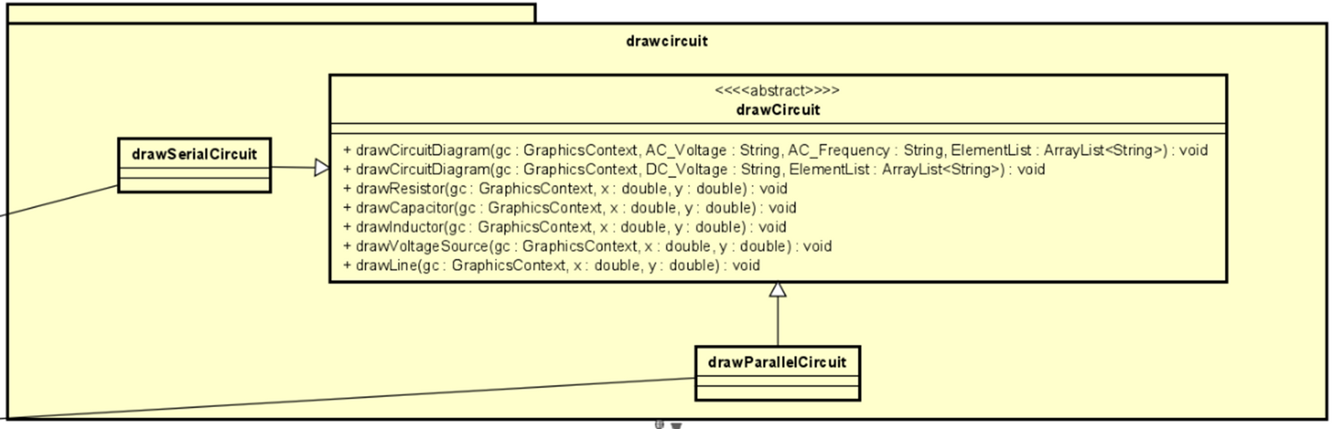
V. OOP TECHNIQUE
2. Polymorphysim
drawCircuit

Slide 21
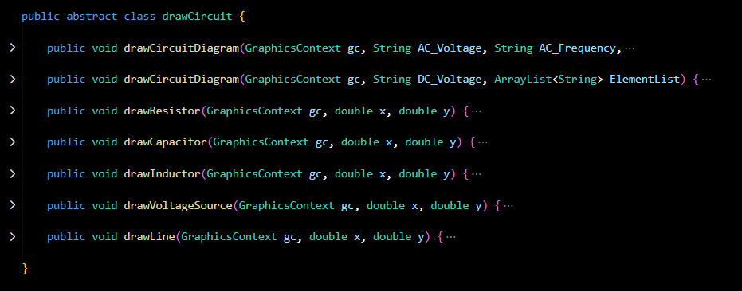
V. OOP TECHNIQUE
2. Polymorphysim

Slide 22
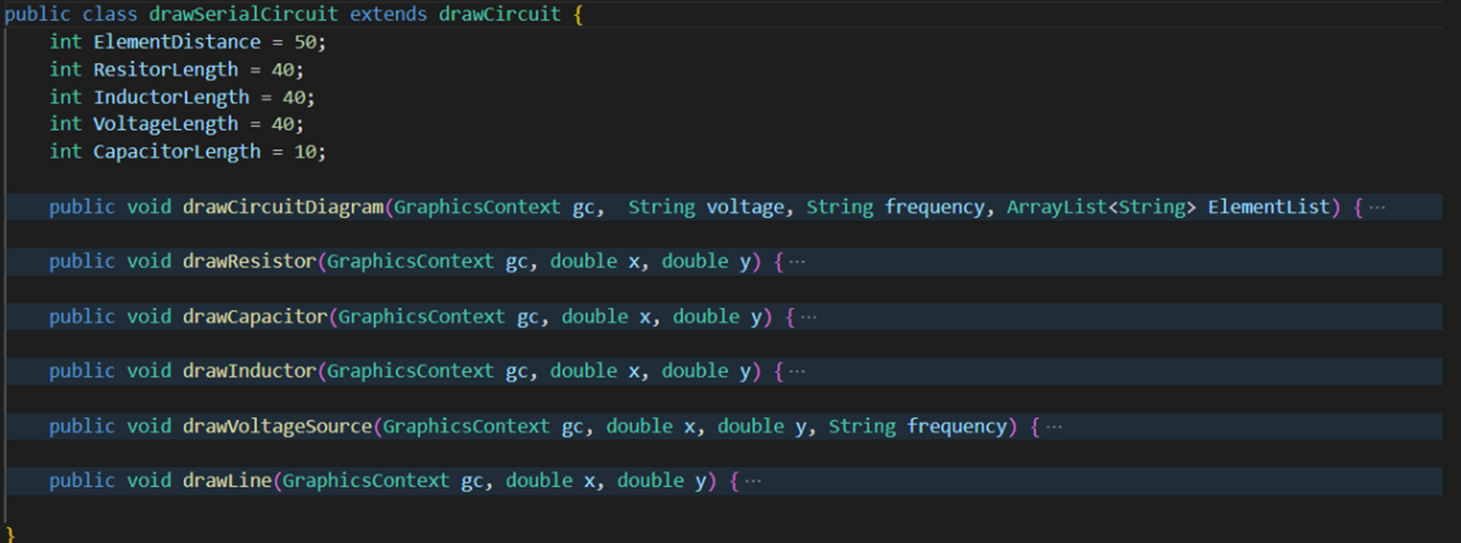
V. OOP TECHNIQUE
2. Polymorphysim

Slide 23
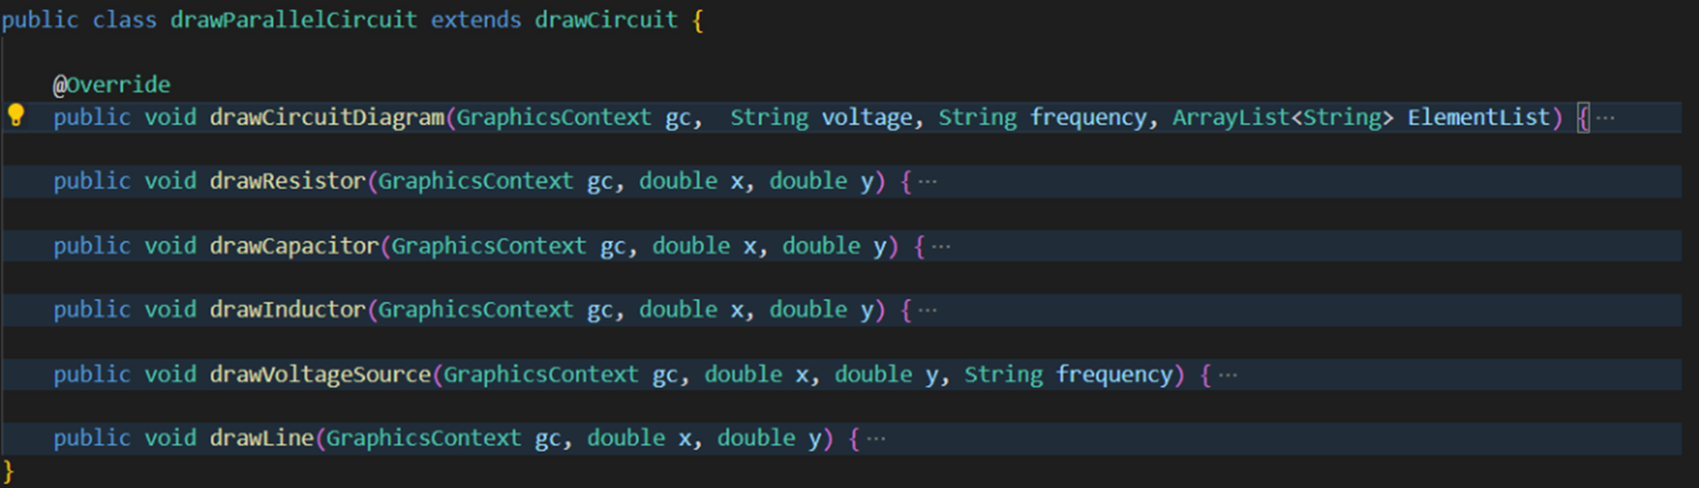
V. OOP TECHNIQUE
2. Polymorphysim

Slide 24
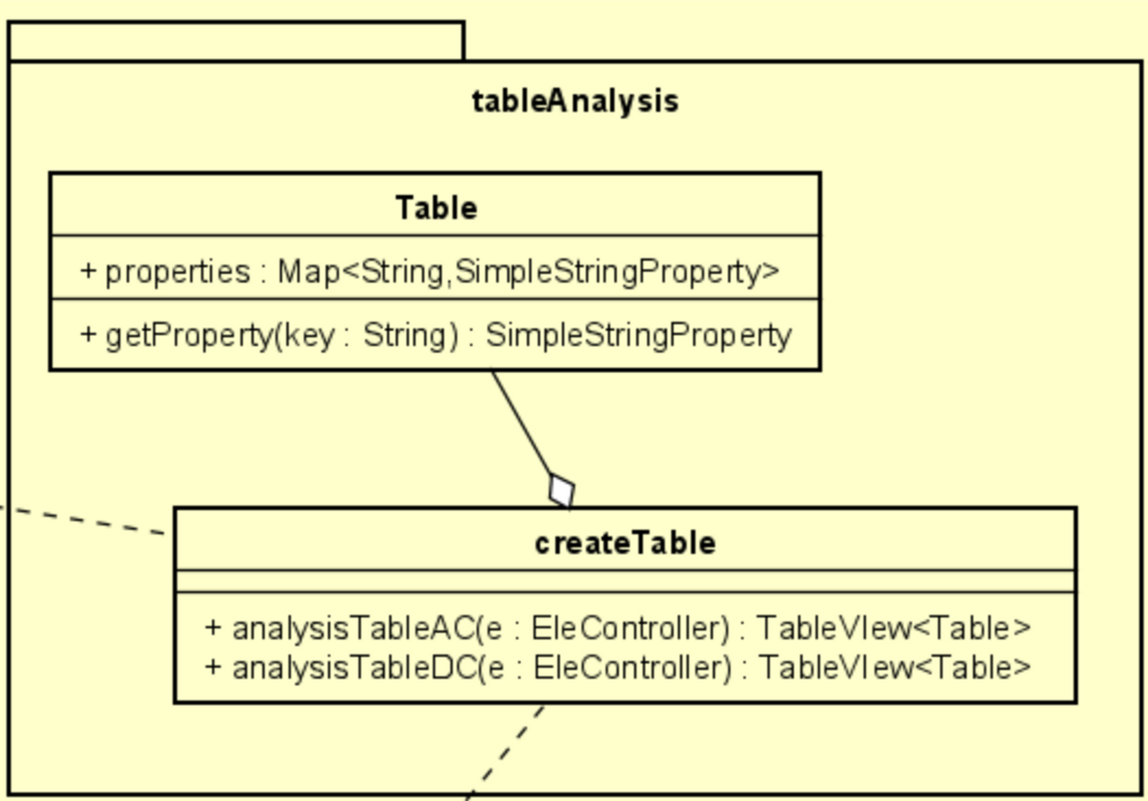
V. OOP TECHNIQUE
3. Aggregation
TableAnalysis

Slide 25
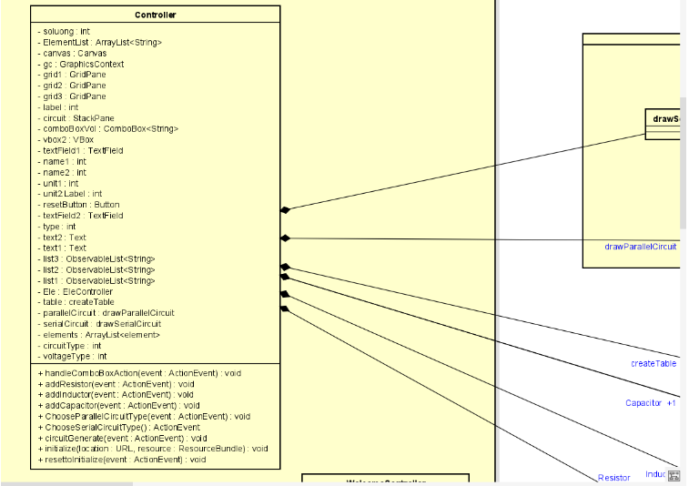
V. OOP TECHNIQUE
4. Composition
Eg: Controller and drawParallelCircuit and drawSerialCircuit

Slide 26
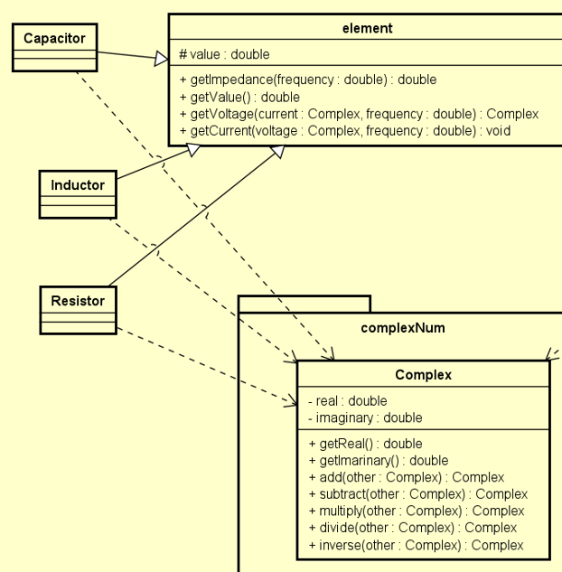
V. OOP TECHNIQUE
5. Dependency
a. Complex and Components

Slide 27
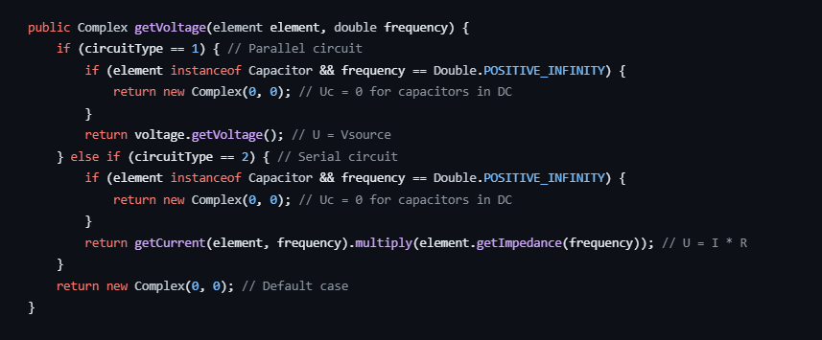
V. OOP TECHNIQUE
5. Dependency
b. Complex and EleController

Slide 28
VI. AI APPLICATION

Slide 29
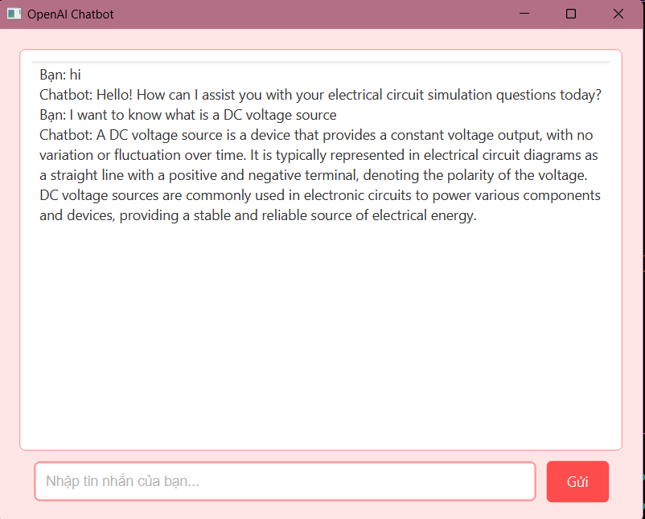
VI. AI Applicaion

Slide 30




THANK YOU
Electronics Circuit Simulator (OOP)

